Slide 1
UNIT 9
Are You Safe Today?

Slide 2


教学步骤
Procedures
1
2
Opening up
Discussion
Conclusion
Homework
3
4

Slide 3
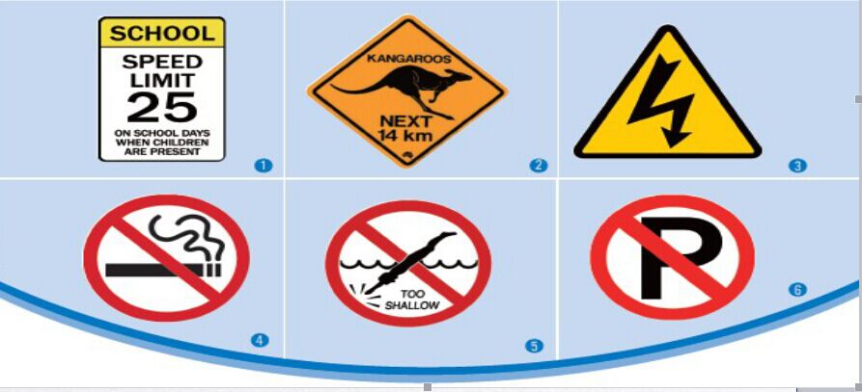
Opening up
Discussion
Conclusion
Homework
Where might these signs be placed？
What are these signs intended to warn against?

Slide 4
Opening up
Discussion
Conclusion
Homework
For reference:
Picture 1: in the school
Picture 2: by the road
Picture 3: near electric devices
Picture 4: in public buildings
Picture 5: at the pool or lake
Picture 6: some place that forbids parking
勿以恶小而为之 遵纪守法很重要

Slide 5
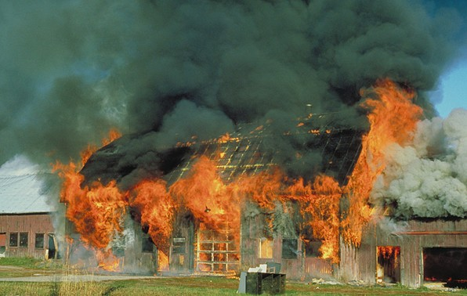
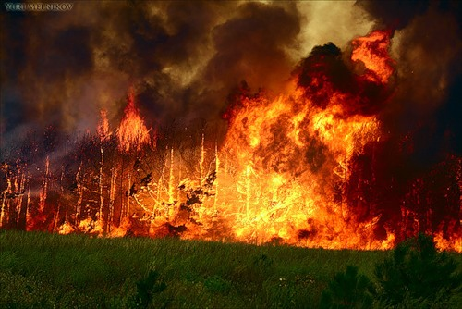

Opening up
Discussion
Conclusion
Homework
What happens in the each of the following pictures?
Why?

Slide 6
Opening up
Discussion
Conclusion
Homework
Work in groups and identify causes of fires .
￭ cigarette butts everywhere
￭ inflammable meterials and products
￭ electric appliances running over-capacity
￭ wiring faults
恶小而为之?

Slide 7
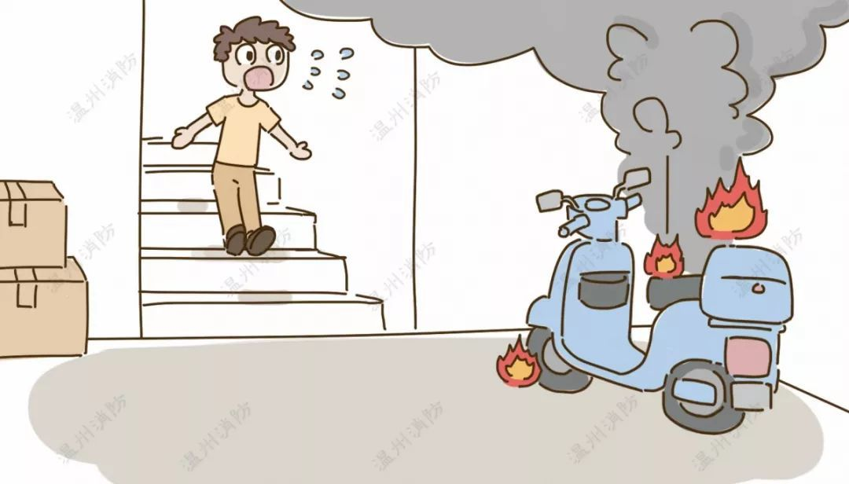
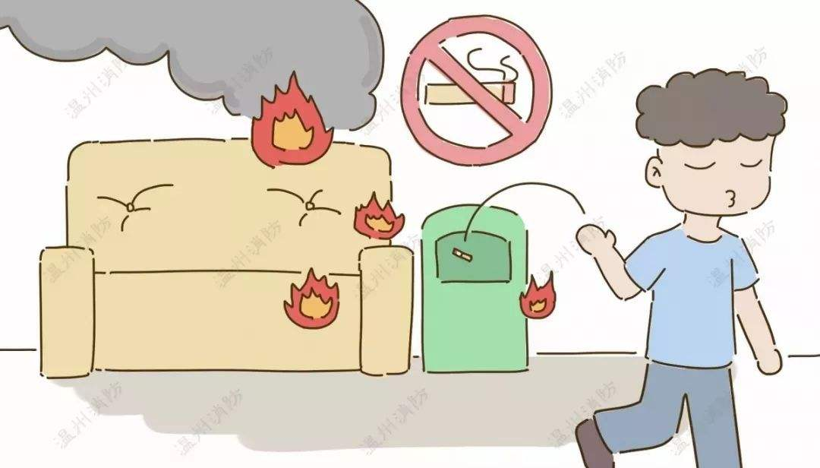
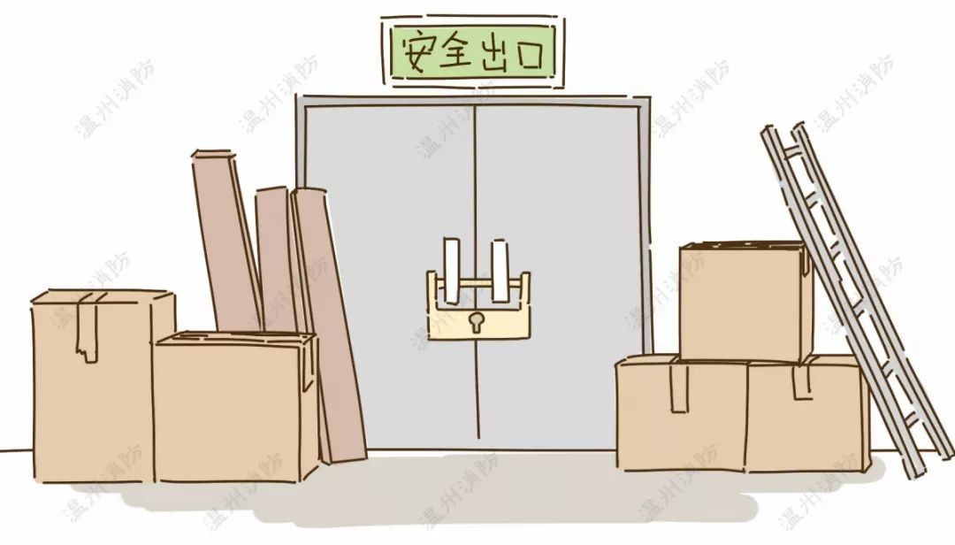
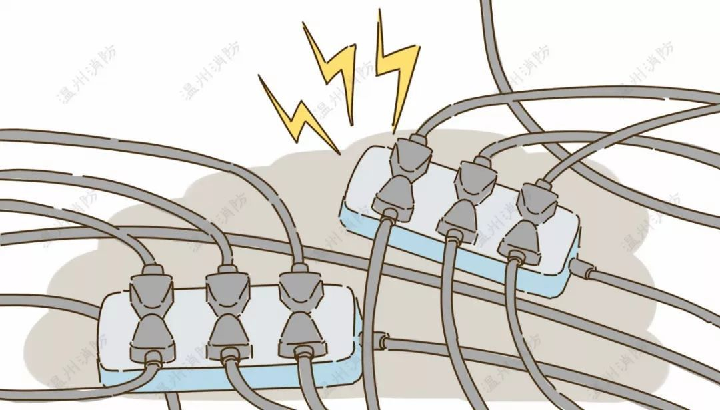
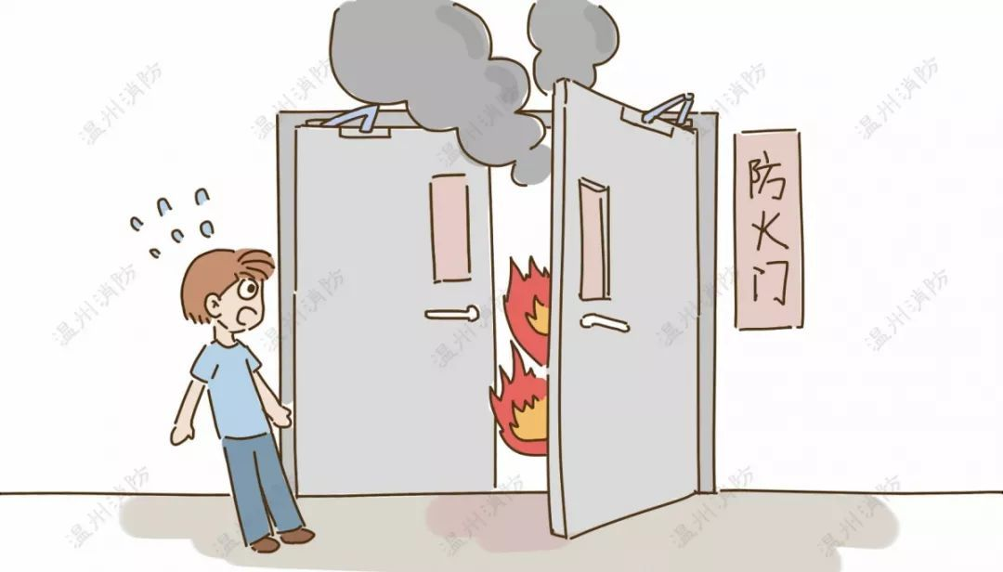
Opening up
Discussion
Conclusion
Homework
Work in groups and identify causes of fires.
恶小而为之?

Slide 8
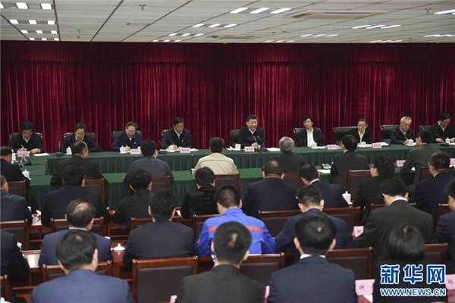
Opening up
Discussion
Conclusion
Homework
要加强思想道德修养，自觉弘扬爱国主义、集体主义、社会主义思想，积极倡导社会公德、职业道德、家庭美德。要牢记‘从善如登，从恶如崩’的道理 。
西方：No act of kindness, no matter how small, is ever wasted. ---Aesop 伊索
2016年4月26日
中国：勿以恶小而为之，勿以善小而不为。

Slide 9
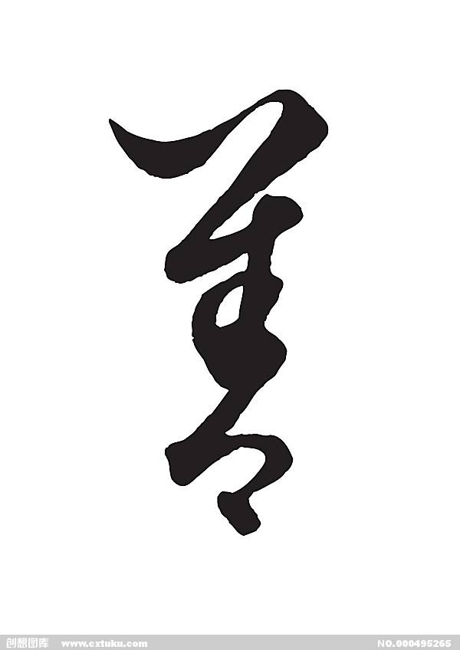

Opening up
Viewing
Practicing
Homework
Homework
Homework 课后任务
Prepare a talk for next class:
How to pass on kindness to others in your daily life?

Slide 10
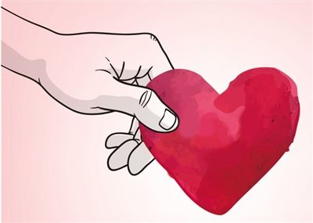
Opening up
Discussion
Conclusion
Homework
Homework
Homework 课后任务
Prepare a talk for next class:
A small act of kindness can
make a big difference.

Slide 11
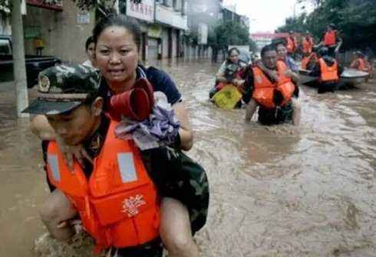
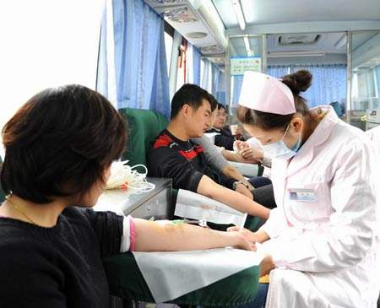
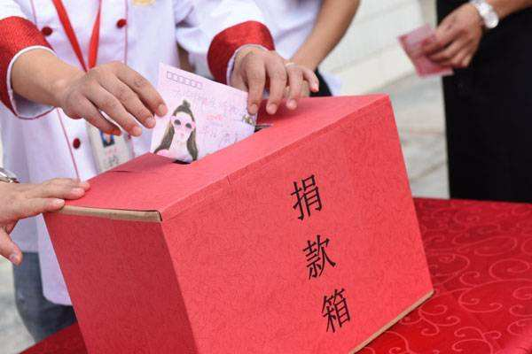
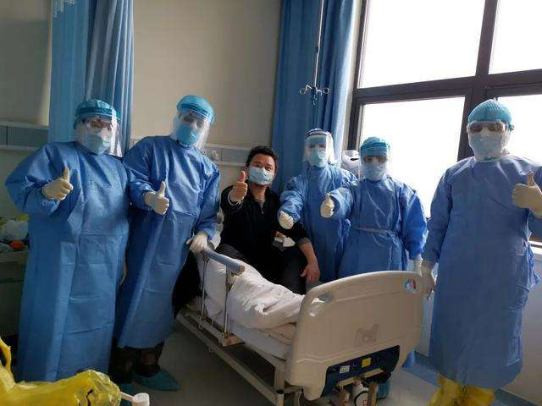
Opening up
Viewing
Practicing
Homework
Homework
Homework 课后任务
Prepare a talk for next class:
Acts of kindness

Slide 12

THANK YOU

